Slide 1
FRI IMPLEMENTATION
VanhGer

Slide 2
Contents
Explain the steps
Demo

Slide 3
Explain the steps

Slide 4
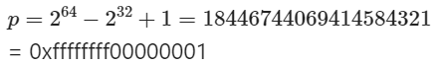
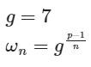
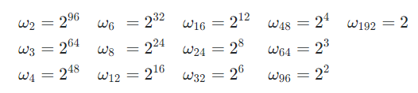
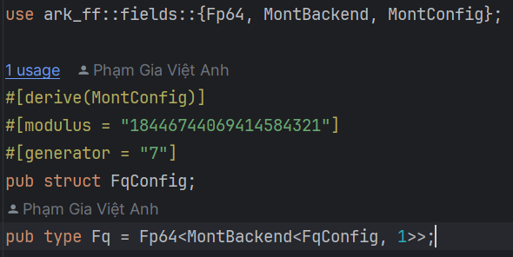
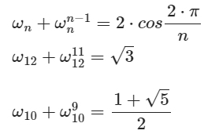
Explain the steps
Field: Goldilocks Generator:
Root of unity:
Compute sqrt:

Slide 5
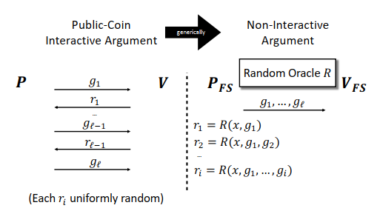
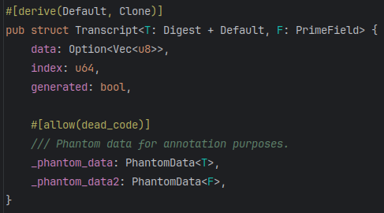
Explain the steps
Fiat-Shamir:

Slide 6
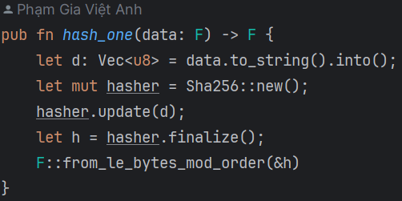
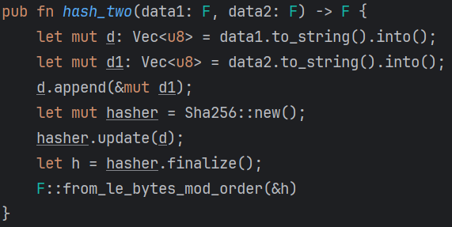
Explain the steps
Prover:
Step1: Create Hash & Merkle Tree
Hash: SHA256

Slide 7
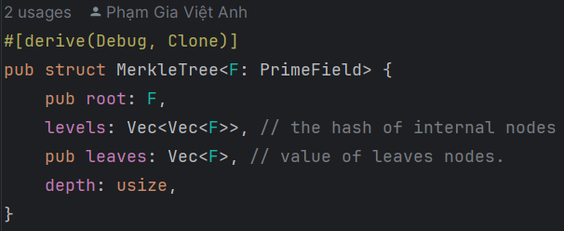
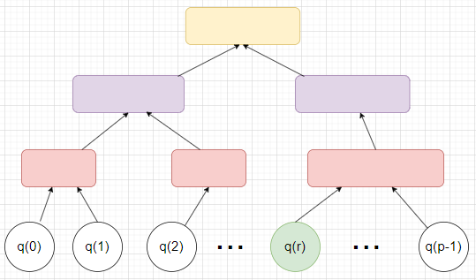
Explain the steps
Step1: Create Hash & Merkle Tree
Merkle Tree
root

Slide 8
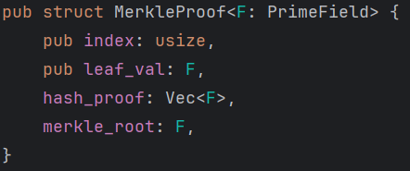
Explain the steps
Step1: Create Hash & Merkle Tree
Merkle Tree Proof
root

Slide 9
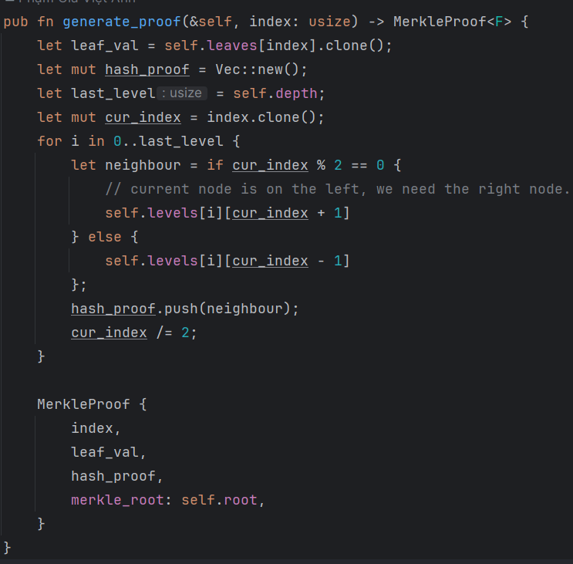
Explain the steps
Step1: Create Hash & Merkle Tree
Merkle Tree Proof
root

Slide 10
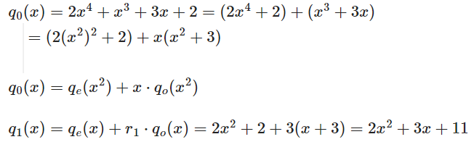
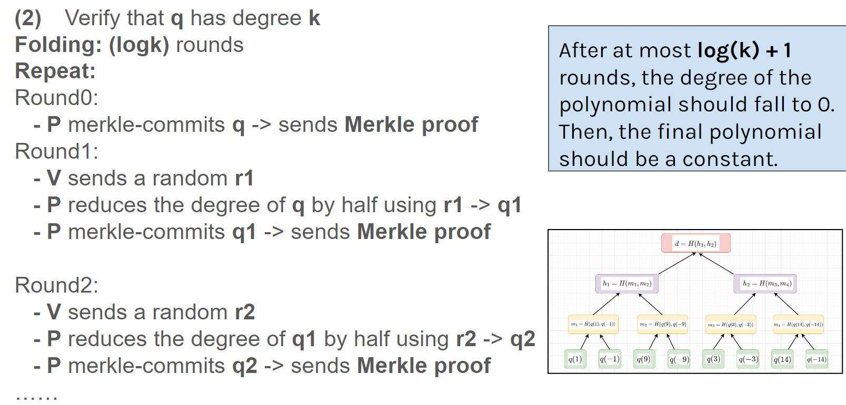
Explain the steps
Step2: Create FRI layer
Each layer represents a polynomial after folding.

Slide 11
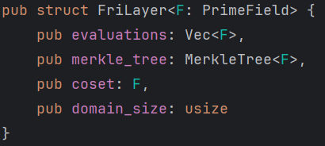
Explain the steps
Step2: Create FRI layer
Each layer represents a polynomial after folding.

Slide 12
Explain the steps
Step3: Folding

Slide 13
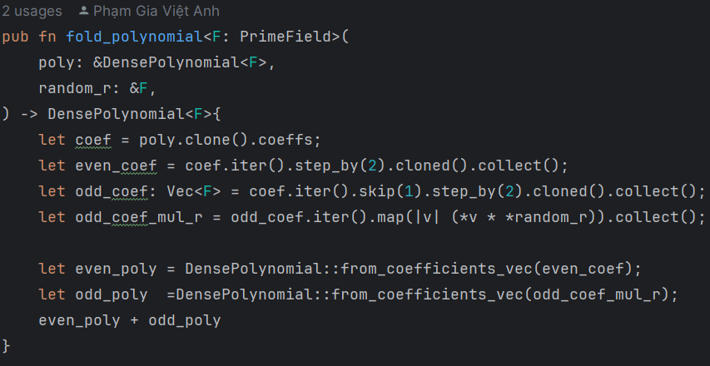
Explain the steps
Step3: Folding

Slide 14
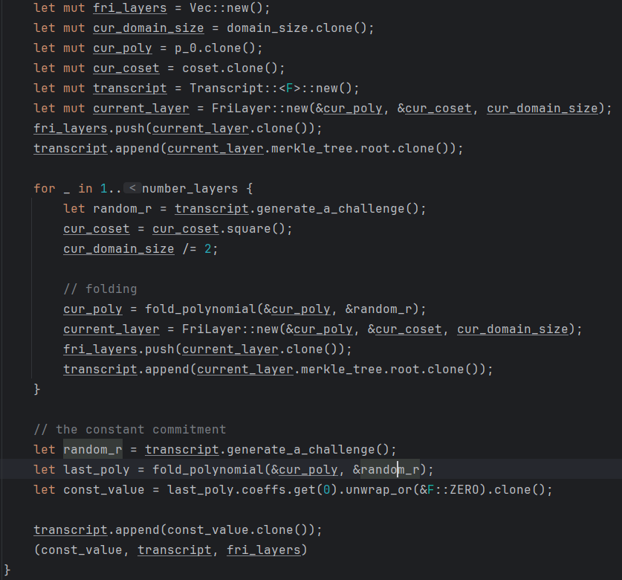
Explain the steps
Step4: Commit phase

Slide 15
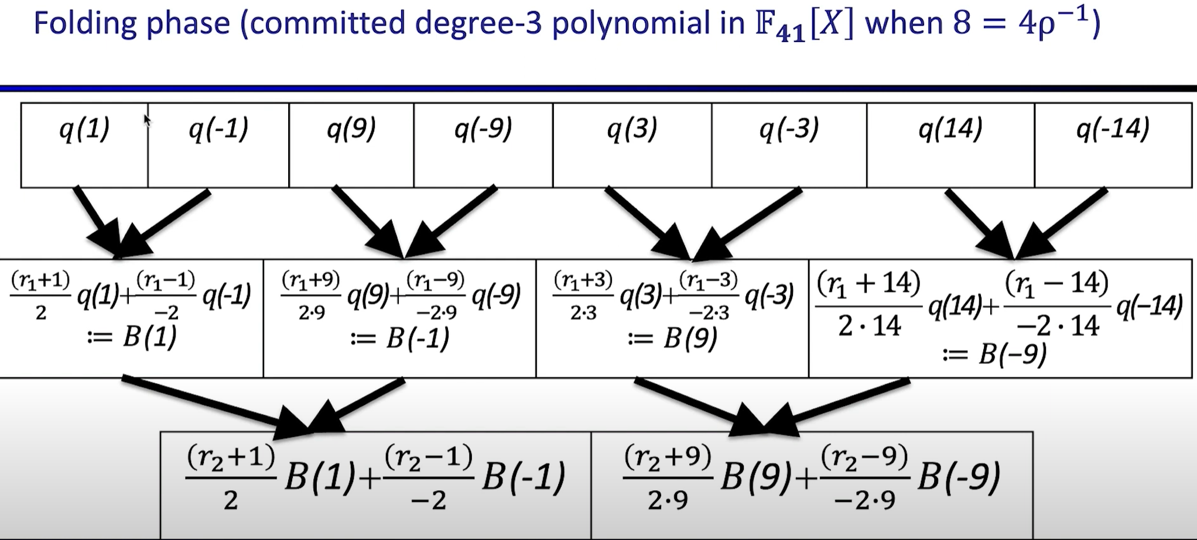
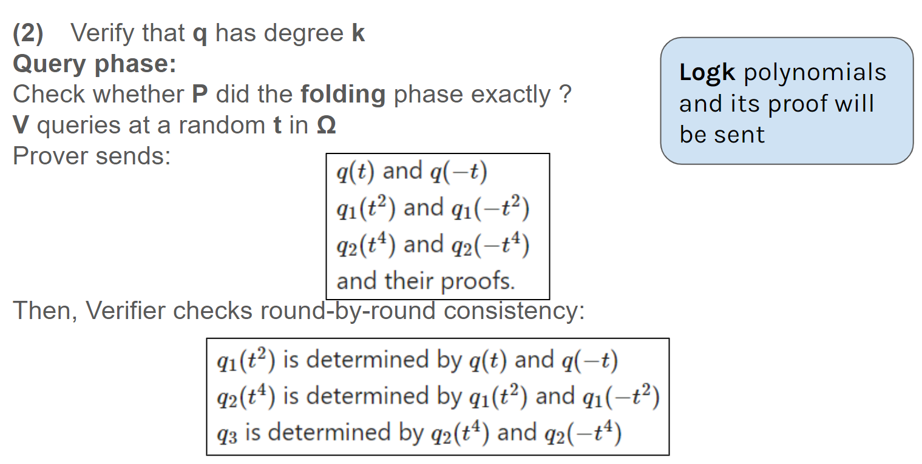
Explain the steps
Step5: Query phase

Slide 16
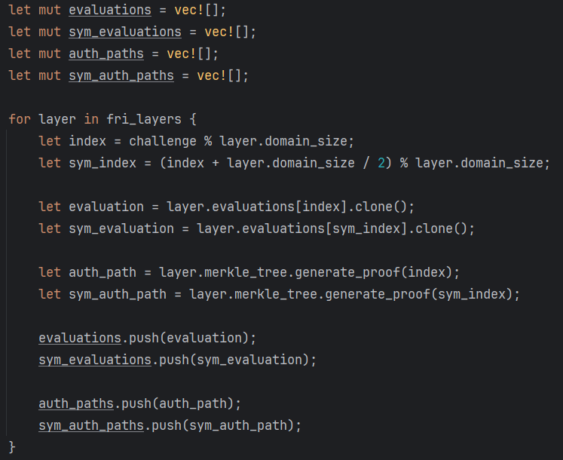
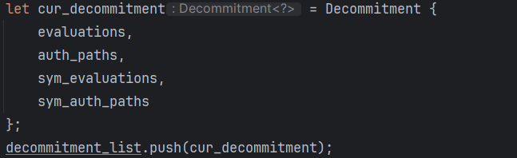
Explain the steps
Step5: Query phase

Slide 17
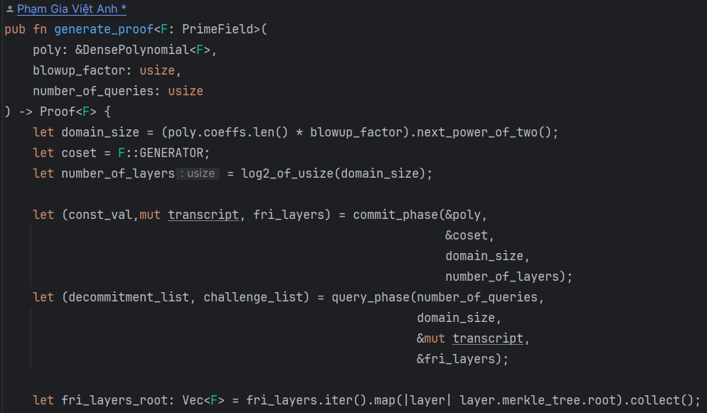
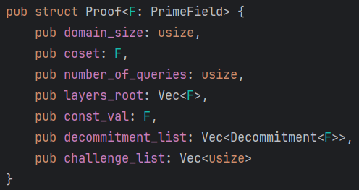
Explain the steps
Step5: Generate proof

Slide 18
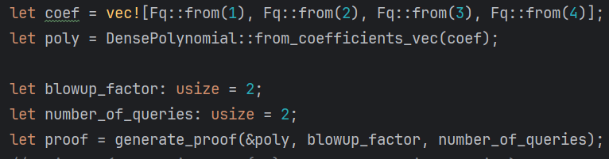
Explain the steps
Step5: Generate proof
Example

Slide 19
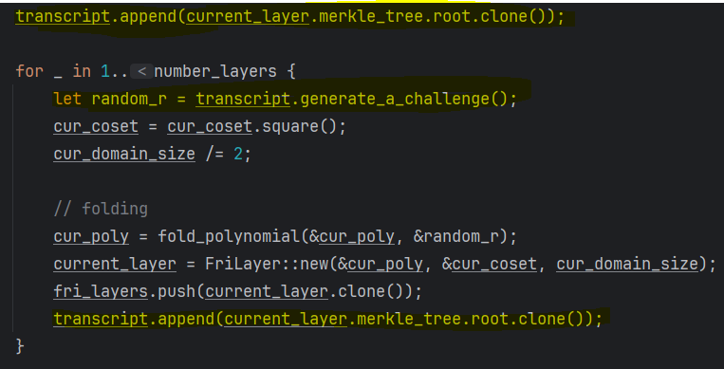
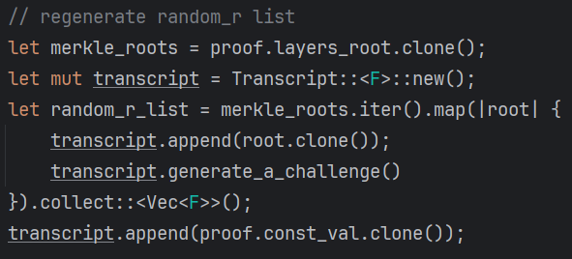
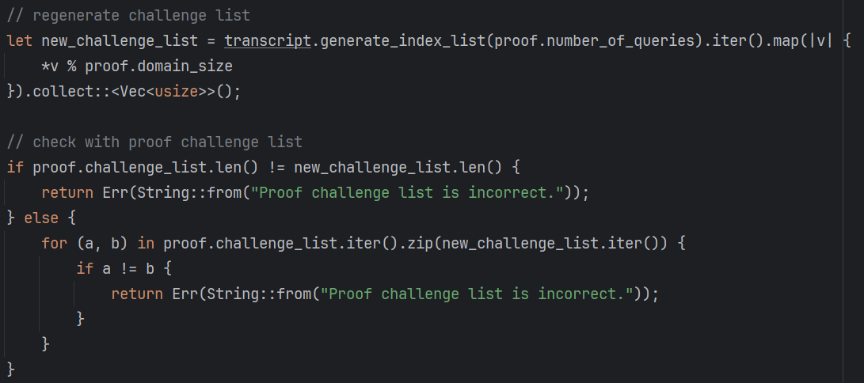
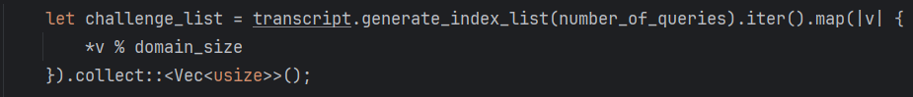
Explain the steps
Prover
Verifier:
Step1: Verify Fiat-Shamir
Verifier

Slide 20
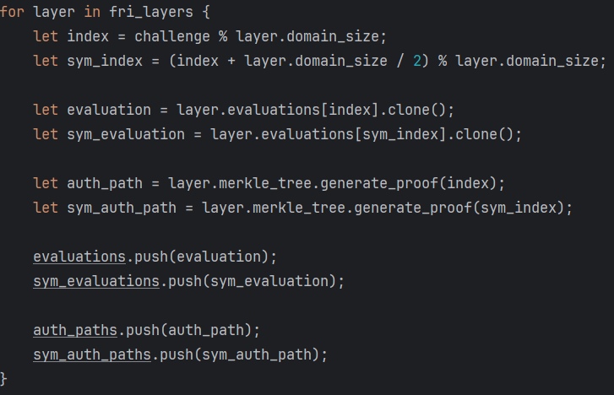
Explain the steps
Verifier:
Prover
Step2: Verify Folding

Slide 21
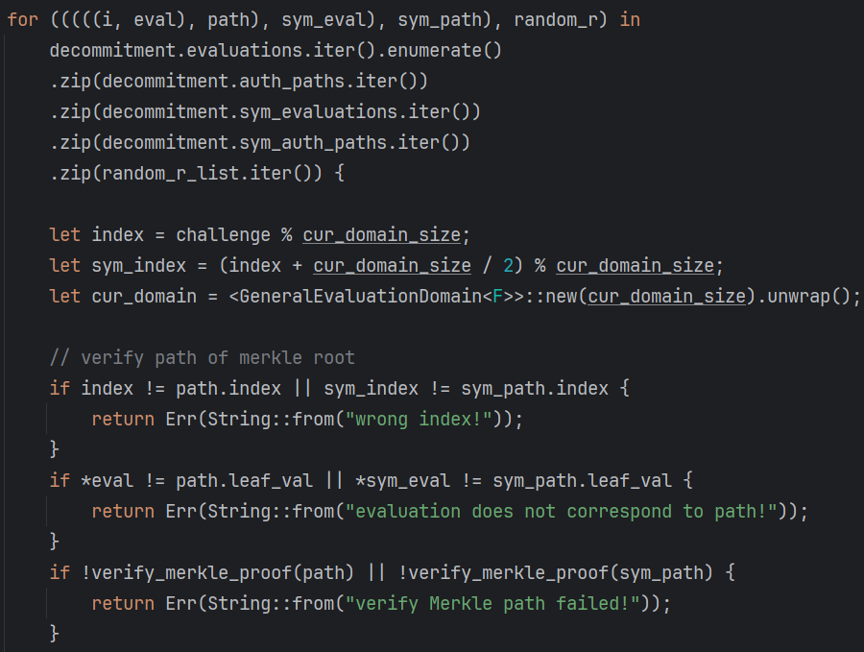
Explain the steps
Verifier:
Prover
Step2: Verify Folding
Verify Merkle path.

Slide 22
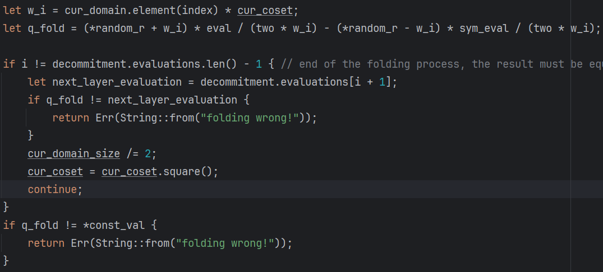
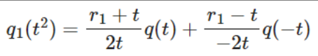
Explain the steps
Verifier:
Step2: Verify Folding

